Slide 1
Employ Attrition Analysis HR Dashboard

Slide 2
Introduction
In the face of persistent employee turnover, XYZ Company has enlisted the expertise of an HR analytics consultancy to tackle the issue head-on. As the HR analyst leading this effort, my role is to dive deep into the data, uncovering the reasons behind the 15% attrition rate over the past few years. Through a comprehensive analytics approach, we aim to provide actionable insights that will empower XYZ Company to make informed decisions and implement targeted strategies for reducing turnover and cultivating a more stable, engaged workforce. This analysis will shed light on the complexities surrounding attrition within XYZ Company, guiding strategic interventions to address specific challenges and aspirations.

Slide 3
Quick Insight
4410
Overall Employee
711
Attrition
16.12%
Attrition Rate
4410
Active Employee

Slide 4
KPIs
Total Employee Attrition: Understanding the overall attrition rate within the company.
Average Age: Examining the average age of employees who leave the company.
Department-wise Attrition and Demographics: Analyzing attrition rates by department and the count of employees over 18 by age and gender.
Job Satisfaction Rating: Assessing employee satisfaction with their roles.
Education Level-wise Attrition: Exploring attrition rates based on employees' educational backgrounds.
Attrition Rate by Age Group: Breaking down attrition rates across different age groups for deeper insights.

Slide 5
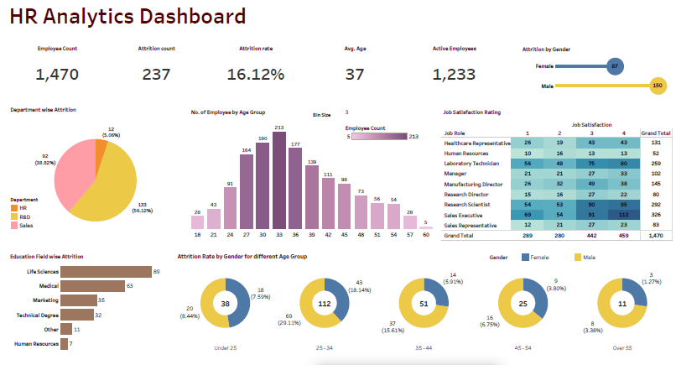
Dashboard

Slide 6
findings
16% of employee leave the company after joining .
Average age of people leaving the company is 37, so most people leave the company after taking experience
Maximum attrition comes from the R & D department i.e 56.12%
Most attrition came from the people who studied life science and medical , so mostly attrition is maximum from biological departments.

Slide 7
Dashboard

Slide 8
Thank you

